Slide 1
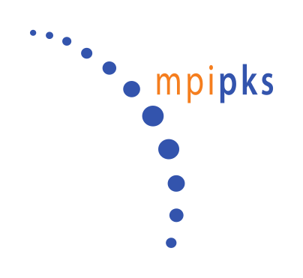



Mechanochemical patterning in cell polarity

Slide 2
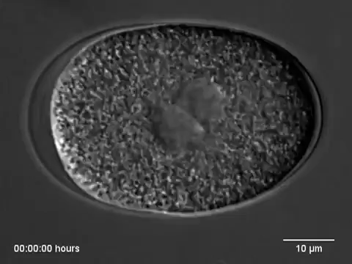
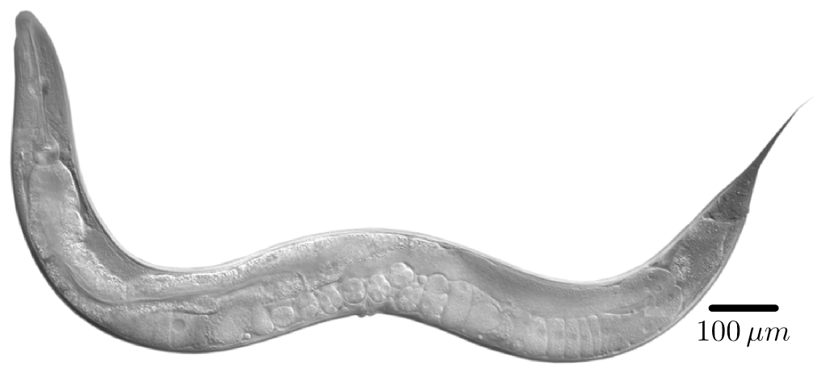
C. elegans
Hyman Lab, MPICBG
Chin Sang Lab
Notes:
Lives in nutrient and bacteria rich environments.
Feed on bacteria that develop in decaying organic matter.
2 sexes — males and hermaphrodites (pictured)

Slide 3
C. elegans development
Chin Sang Lab
Notes:
Lives in nutrient and bacteria rich environments.
Feed on bacteria that develop in decaying organic matter.
2 sexes — males and hermaphrodites (pictured)

Slide 4

Hyman Lab, MPICBG

Slide 5
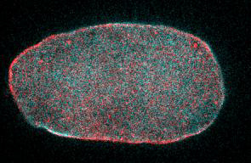
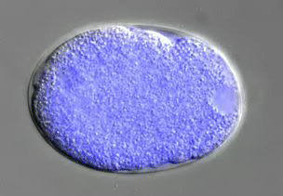
C. elegans polarization
PAR polarity
A
P
Size asymmetry
Composition asymmetry
PIE-1
Notes:
(2) EGFP-PIE-1 fusion protein, dual time-lapse DIC and fluorescence microscopy, 100x

Slide 6
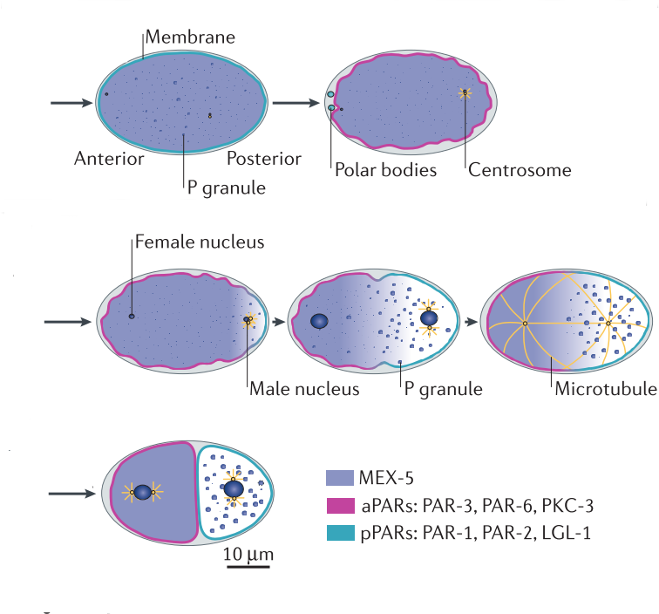
C. elegans one-cell polarity
Fertilization (0 min)
PAR polarity
Cell surface
polarity
Surface flows start
Cell division (55 min)
Surface
polarity proteins
Hoege and Hyman, Nat Rev Mol Cell Biol (2013)

Slide 7

C. elegans one-cell polarity
A
P
PAR6
PAR2
Anterior
Posterior
How is this polarity on the cell surface established?

Slide 8
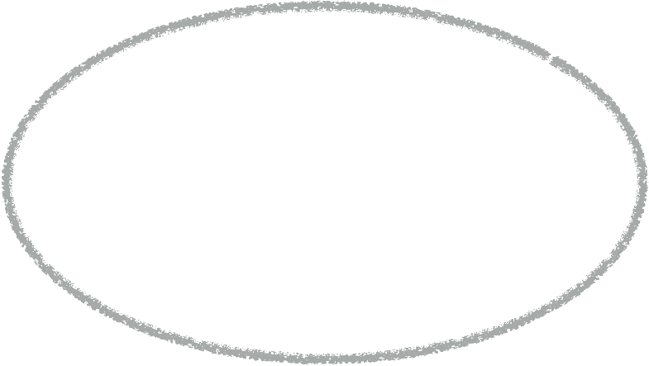

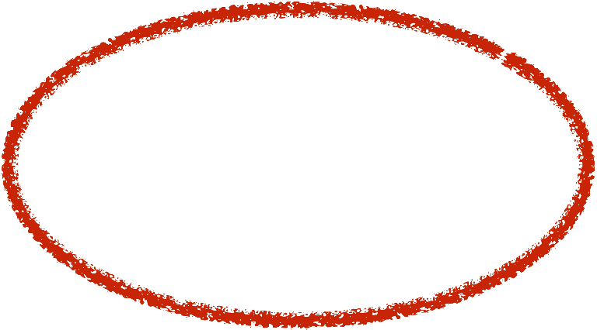
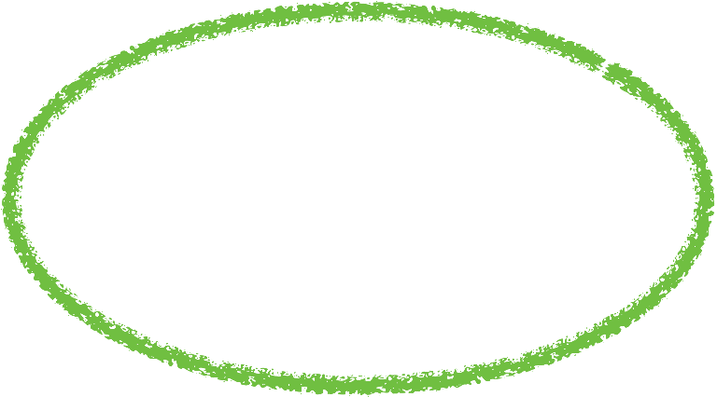


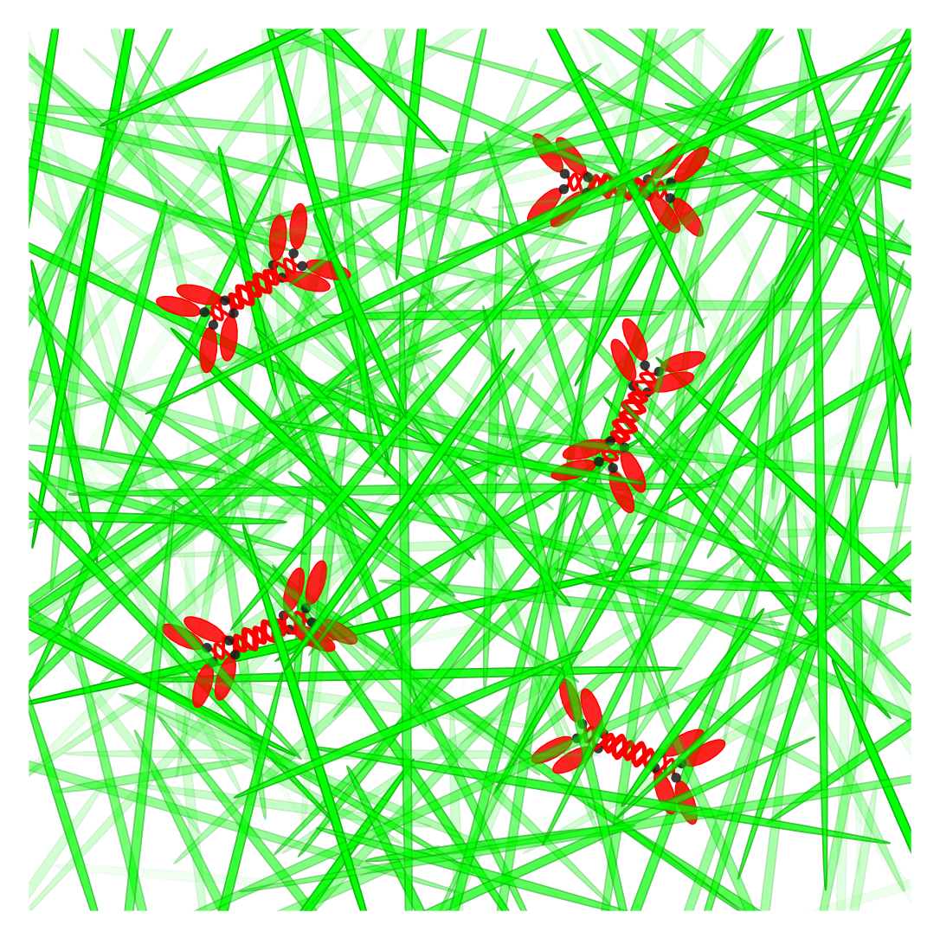
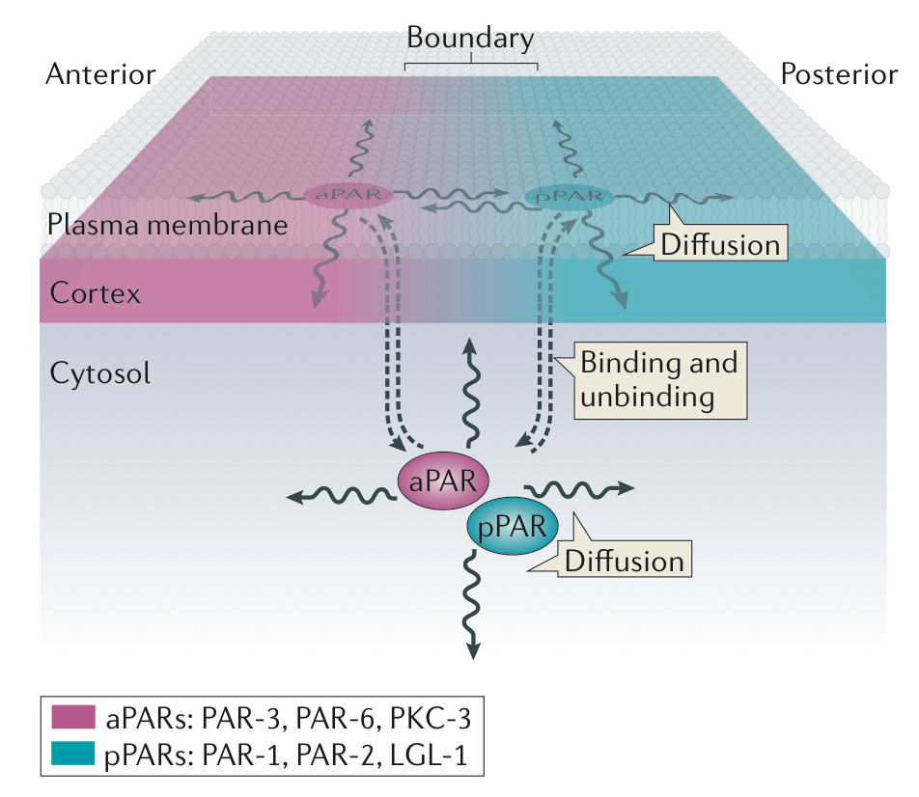
The surface of the Cell
Cell membrane
Cortex
Cytoplasm
Turnover
F-Actin
Myosin
Notes:
Major components are (1) F-Actin, (2) Myosin filaments, (3) Actin binding proteins
EM of black tetra keratocytes

Slide 9
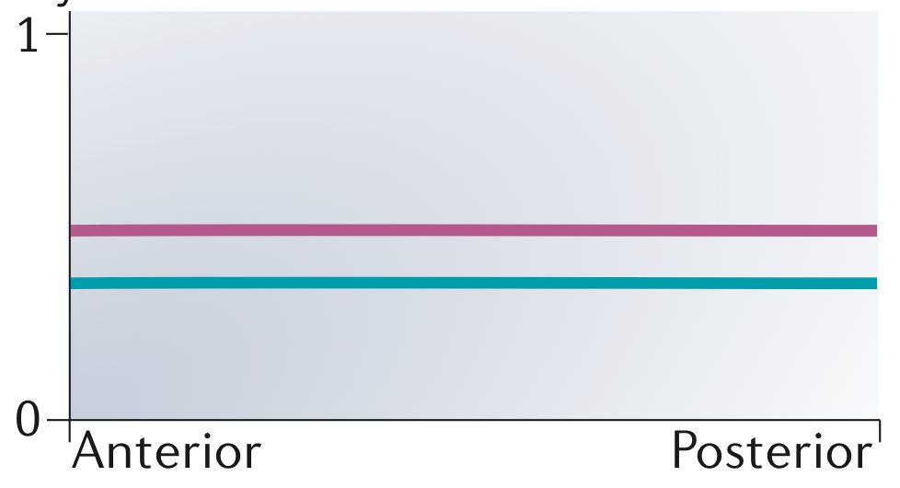
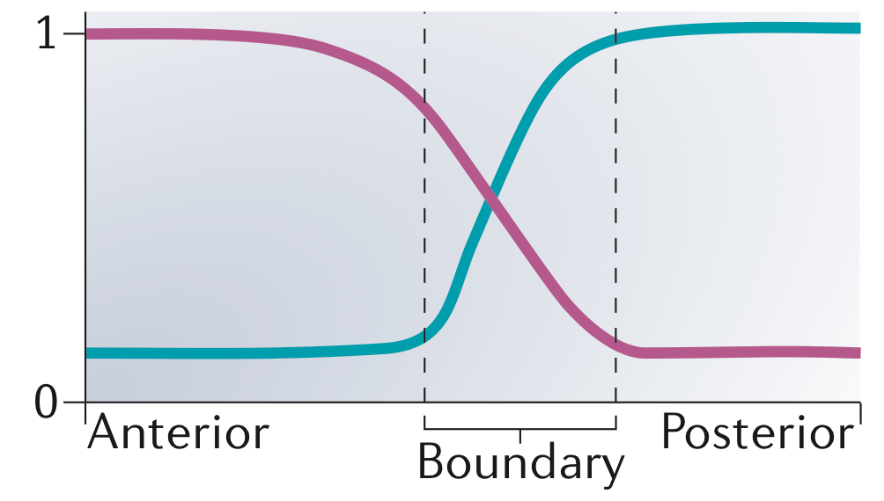
PAR polarity in C. elegans
Bistability
10mts
Hoege & Hyman, Nat Rev Mol Cell Biol (2013)
Notes:
Phosphorylation sites (red) — PKC-3 phosphorylates
pPARs, & PAR-1 phosphorylates PAR-3

Slide 10


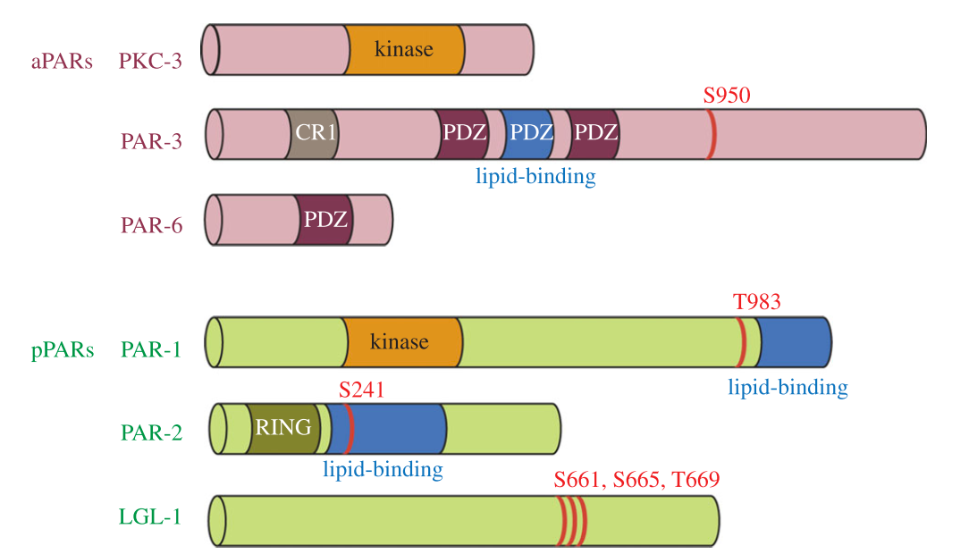
PAR polarity in C. elegans
What triggers
the transition?
Bistability
Antagonistic interactions
A
P
Mutual phosphorylation of
A & P complexes
Motegi & Seydoux, Phil Trans R Soc B (2013)
Notes:
Phosphorylation sites (red) — PKC-3 phosphorylates
pPARs, & PAR-1 phosphorylates PAR-3

Slide 11
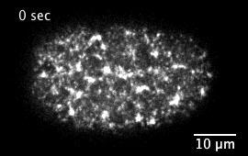
Cortical surface flows
C. elegans one-cell stage embryo
Flow
Anterior
Posterior
A
P
myosin
Mirjam Mayer

Slide 12
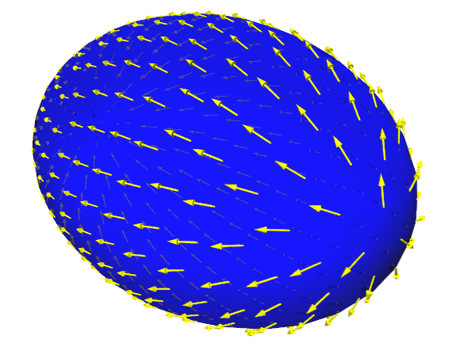
PAR polarity in C. elegans
Start of cortical surface flows
Cortical flows
trigger
the transition

Slide 13
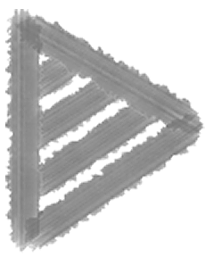
PAR polarity in C. elegans
A
P
Anterior and Posterior PARs are mutually antagonistic
After fertilization, PARs are homogeneously distributed on the cell surface
Centrosome initiates surface flows
from posterior pole…
surface flows transport PAR proteins
Transport + Mutual antagonism set up PAR domains

